Slide 1
In The Name of God
Genetics of Primary Ovarian Insufficiency
Dr.Dianatpour
Medical Geneticist
1402

Slide 2
Introduction
Genetic Causes of POI
Implications of Genetic Diagnosis

Slide 3
Introduction
Human Genome Project
NGS (WES)
Guidelines and Classifications Have been Changed.
Post Genomic Era

Slide 4
Premature ovarian insufficiency (POI)
Premature ovarian insufficiency (POI), characterized by cessation of ovarian function, affects 3.7% of women before the age of 40 years and remains a common cause of female infertility. The etiologies of POI are highly heterogeneous, and it can be caused by spontaneous genetic defects or induced by autoimmune diseases, infections or iatrogenic factors.

Slide 5
Genetics of POI
X Chromosome aneuploidy
FMR1 Per mutation (55 to 200 CGG repeats)
NGS (WES)
Segregation Analysis in Family
More families
Animal model

Slide 7
1030 participants
Cumulatively, pathogenic and likely pathogenic variants in known POI-causative and novel POI-associated genes contributed to 242 (23.5%) cases. Further genotype–phenotype correlation analyses indicated that genetic contribution was higher in cases with primary amenorrhea compared to that in cases with secondary amenorrhea.

Slide 9
Methods
375 patients with 70 families were studied using targeted (88 genes) or whole exome sequencing with pathogenic/likely-pathogenic variant selection.

Slide 10
Findings
A high-yield of 29.3% supports a clinical genetic diagnosis of POI. In addition, we found strong evidence of pathogenicity for nine genes not previously related to a Mendelian phenotype or POI: ELAVL2, NLRP11, CENPE, SPATA33, CCDC150, CCDC185, including DNA repair genes: C17orf53(HROB), HELQ, SWI5 yielding high chromosomal fragility.
The causal role of BRCA2, FANCM, BNC1, ERCC6, MSH4, BMPR1A, BMPR1B, BMPR2, ESR2, CAV1, SPIDR, RCBTB1 and ATG7 previously reported in isolated patients/families. In 8.5% of cases, POI is the only symptom of a multi-organ genetic disease.

Slide 11
Findings
New pathways were identified: NF-kB, post-translational regulation, and mitophagy (mitochondrial autophagy), providing future therapeutic targets. Three new genes have been shown to affect the age of natural menopause supporting a genetic link.

Slide 15
Why Genetic Tests are required?

Slide 16
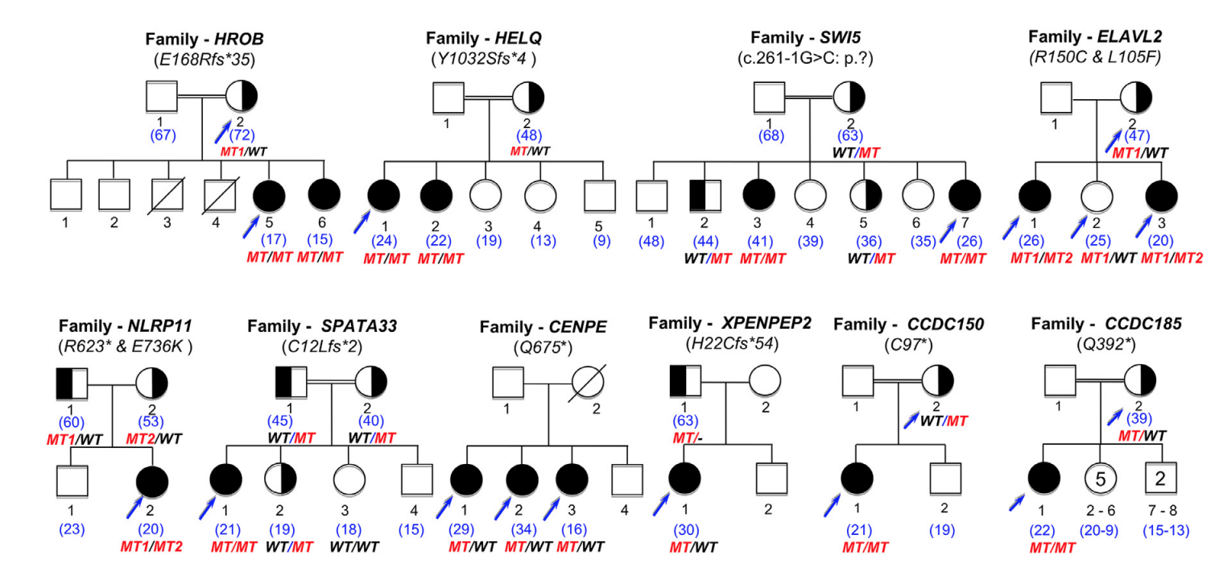
Prevention and preservation
Family screening

Slide 17
Other Treatments
Personalized Medicine
In vitro follicular activation (IVA)
Immunotherapy
Stem cell Therapy
Exosome Therapy
Gene therapy
Mitochondrial Activation

Slide 18
Implications of all the available evidence
Personalized Medicine
Genetics is also critical to establish a fertility prognosis for the promising technique of in vitro follicular activation (IVA) in the future by predicting a residual ovarian reserve (60.5% of cases). The selection of patients who could benefit from this technique, the genetic cause highlighting existing follicles in the ovaries blocked in their growth, could clearly improve its success in the treatment of infertility of POI. The pathways identified could also provide future therapeutic targets.

Slide 20
Implications of all the available evidence
Comorbidities related to tumour/cancer susceptibility genes
A high-performance genetic diagnosis of POI, is critical to understand the pathogenesis of POI and leading to personalized medicine. These results have major implications for preventing/curing comorbidities related to tumour/cancer susceptibility genes that could affect lifespan or multi-organ disease revealed by genetics.
Apart from the infertility of patients, it is therefore their entire state of health that must be assessed and treated as soon as the patient consults for POI.

Slide 21
POI and ANM
Three genes had been implicated in the large variance in the age of natural menopause (ANM), confirming a genetic link and a continuum between the two conditions, the difference may be related to the severity of the genetic variants involved, major in POI.

Slide 22
Genetic Tests
Karyotype
WES
FMR1

Slide 24
Thank You

Slide 25
Molecular regulation of IVA
IVA mainly involves phosphatase and tensin homolog (PTEN)/phosphatidylinositol-3-kinase (PI3K)/protein kinase B (Akt)/forkhead box O3 (FOXO3) signaling pathway, and the Hippo signaling pathways (Fig. 2). The PTEN/PI3K/Akt/FOXO3 pathway plays a central role in PFs activation. The cognate tyrosine kinase receptor initiates Akt activation signaling by enhancing PI3K activity, which converts secondary messenger, phosphatidylinositol-4,5-bisphosphate (PIP2), into phosphatidylinositol-3,4,5-triphosphate (PIP3). Subsequently, PIP3 activates phosphatidylinositol-dependent kinase 1 (PDK1), resulting in Akt activation [9], a key kinase in this pathway. Once Akt is activated, FOXO3a is hyperphosphorylated and undergoes nuclear exportation, eventually triggering PFs activation. Furthermore, Akt phosphorylates tuberous sclerosis 2 (TSC2), which inactivates TSC1/TSC2 complex and induces mammalian target of rapamycin complex (mTORC1). Subsequently, mTORC1 and its substrates promote PFs survival [10]. However, these events are reversed by the effects of PTEN, which negatively regulates this pathway by transforming PIP3 back to PIP2 [11].

Slide 26
Translation of IVA in the practice of human reproduction
IVA has been successfully applied in clinical practice. Conventional IVA in POI patients was the combination of PTEN inhibitors and PI3K activators, followed by ovarian fragmentation and autografting cortical strips via laparoscopic surgery. This procedure resulted in two pregnancies and one healthy delivery [14]. In 2016, Zhai et al. reported a successful delivery after simplifying IVA by fresh tissue auto-transplantation [29].
Drug-free IVA was developed more recently. It focuses only on disrupting the Hippo pathway and avoids chemical activation of ovaries. A growing number of studies have reported that drug-free IVA had led to successful pregnancies [30, 31]. However, these results should be interpreted with caution because most of these studies, involved a limited number of patients and lacked controlled trials.

Slide 27
Mitochondria and ovarian aging
Ovarian aging caused by mitochondrial dysfunction involves mtDNA dysfunction, enhanced oxidative damage, altered membrane potential and inefficient biogenesis or mitochondria clearance [37]. Of these, mtDNA dysfunction includes decreased mtDNA content, strand breaks, point mutations, and oxidative damage. Patients with POI reportedly exhibited significantly decreased mtDNA content compared to healthy fertile women [38]. Furthermore, mtDNA is prone to mutations due to the absence of histone protection and DNA repair enzymes [39]. Studies have shown that a single-point alteration in mtDNA profoundly influences mitochondrial proteostasis and reactive ROS generation, leading to telomere shortening [40]. Moreover, the introduction of mutated mtDNA polymerase gamma (POLG) into a mouse caused premature senescence [41].

Slide 28
Mitochondrial nutrient therapy
In recent years, researchers have focused on using pharmacological methods to restore the vitality of mitochondria. Available mitochondrial nutrients include Coenzyme Q10 (CoQ10), resveratrol, melatonin, and rapamycin [48]. CoQ10 is a component of the mitochondrial electron transport chain and a cellular antioxidant, which reportedly delays the depletion of ovarian reserve [49]. Importantly, the only human trial conducted so far, has shown that supplementation with CoQ10 may reduce the rate of aneuploidy in oocytes after meiosis. However, the result of this study was not statistically significant due to the study being prematurely terminated due to safety considerations [50].

Slide 29
Mitochondrial transfer therapy
Various mitochondrial transfer therapies have been tested for infertility management. A previous study has reported that allogeneic ooplasmic transfer in human oocytes led to successful pregnancy and live birth [54]. However, this technique was suspended due to the risk of heteroplasmy, and potential transmission of mitochondrial diseases, as well as Turner syndrome and autism cases being reported following transplantation [55]. Subsequently, new nuclear transplantation techniques, including spindle transplantation, germinal vesicle (GV) transplantation, and pronuclear transplantation (PNT), have been proposed.

Slide 30
Stem cell therapy for POI
Although ESCs show unlimited potential for differentiation, clinical use of ESCs is limited. This is because the use of ESCs raises challenging ethical issues, such as the destruction of blastocysts. By contrast, iPSCs, which are prepared by reprogramming human somatic cells, may be used without any ethical issues. Yamashiro et al. confirmed that human iPSCs could differentiate into human primitive germ-like cells (hPGCLCs) in vitro. More importantly, hPGCLCs cultured under defined conditions differentiated into oogonia/gonocyte-like cells [69].

Slide 31
Cell-free therapy for POI
Treating POI with exosomes is associated with higher clinical safety, because immune rejection and the risk of vascular obstruction and tumor mutation can be avoided by using exosomes. A recent study revealed that exosomal miR-644-5p derived from BMSCs targeted the regulation of p53 to suppress the apoptosis of GCs, thus alleviating POI [82]. In 2020, Yang et al. reported that BMSCs-derived exosomal miR-144-5p relieved POI by targeting PTEN to inhibit GC apoptosis [83]. In addition, overexpression of miR-21, a key miRNA that regulates apoptosis in BMSCs, repaired ovarian structure and function in rats, by downregulating PTEN and the programmed cell death protein 4 (PDCD 4) [84].

Slide 32
PRP intra-ovarian infusion
Mechanisms of PRP in POI
Intra-ovarian infusion of PRP is another novel approach to the treatment of POI. PRP is composed of high concentrations of platelets obtained from the peripheral blood of patients via centrifugation [98]. The efficiency of PRP depends mainly on their α-granule content, which is highly enriched in proteins, hormones, and growth factors [99]. The release of bioactive proteins promotes cell proliferation and differentiation [101]. In addition, activated platelets release high concentrations of hormones and growth factors, which stimulate angiogenesis as well as anabolism and inflammation control, thereby rapidly promoting the healing and regeneration of tissues [102]. Importantly, GD

Slide 33
MicroRNAs: the future direction of POI treatment
MicroRNAs (miRNAs) are short, 18–24 nucleotides long, non-coding RNAs [118]. These regulate cell proliferation, differentiation, and apoptosis in normal and pathological processes [119]. The expression levels of miRNAs in reproductive tissues appears to be linked to fertility potentials and embryo developmental capacities [120]. Furthermore, miRNAs play a regulatory function in folliculogenesis and oocyte maturation [119] and are detected in plasma, serum, and urine. Currently, plasma miRNAs are considered as promising potential biomarkers for a series of cancers and other diseases.

Slide 35
However, a large proportion of cases with POI are idiopathic, with multiple lines of evidence supporting a genetic basis for pathogenesis⁵. Identifying the molecular basis of POI is, thus, of paramount importance for investigating therapeutic targets, such as in vitro activation, and for guiding genetic counseling or pregnancy planning.

Slide 36
Premature ovarian insufficiency (POI) is a major cause of female infertility due to early loss of ovarian function. POI is a heterogeneous condition, and its molecular etiology is unclear. To identify genetic variants associated with POI, here we performed whole-exome sequencing in a cohort of 1,030 patients with POI. We detected 195 pathogenic/likely pathogenic variants in 59 known POI-causative genes, accounting for 193 (18.7%) cases.

Slide 37
Association analyses comparing the POI cohort with a control cohort of 5,000 individuals without POI identified 20 further POI-associated genes with a significantly higher burden of loss-of-function variants. Functional annotations of these novel 20 genes indicated their involvement in ovarian development and function, including gonadogenesis (LGR4 and PRDM1), meiosis (CPEB1, KASH5, MCMDC2, MEIOSIN, NUP43, RFWD3, SHOC1, SLX4 and STRA8) and folliculogenesis and ovulation (ALOX12, BMP6, H1-8, HMMR, HSD17B1, MST1R, PPM1B, ZAR1 and ZP3). enetic screenings.

Slide 38
Cumulatively, pathogenic and likely pathogenic variants in known POI-causative and novel POI-associated genes contributed to 242 (23.5%) cases. Further genotype–phenotype correlation analyses indicated that genetic contribution was higher in cases with primary amenorrhea compared to that in cases with secondary amenorrhea. This study expands understanding of the genetic landscape underlying POI and presents insights that have the potential to improve the utility of diagnostic g

Slide 39
To get insight into this disorder, we studied the feasibility of a first line genetic diagnosis in a large cohort of 375 patients including 70 families and looked for new responsible genes and altered signalling pathways. We have sequenced either the whole coding part of the genome or 88 known causing genes. A high-yield diagnosis of 29.3 % was obtained supporting the use of genetics routinely to diagnose all unexplained POI. Interestingly, we identified 9 genes not previously related to POI or Mendelian disease and confirm 13 others previously reported in isolated patients or families.

Slide 40
We showed how the molecular dissection of the pathways involved leads to personalized management of patients. The main family is the DNA repair/meiosis/mitosis gene family (37.4% of cases), but it is also a tumour/cancer susceptibility gene family. Lifelong monitoring is therefore necessary to prevent or treat the appearance of these tumours. The second major family involved is that of follicular growth genes (35.4%). Strikingly, in 8.5% of cases, POI is the only single visible expression of a complex multi-organ genetic disease. A full patient assessment is required. Other novel pathways identified could yield novel therapeutic targets: i.e. immunity, gene regulation, mitochondrial autophagy.

